Slide 1
SEMESTER-VI
Organic Chemistry
Paper- CEMMJ 12 (Major)
Topic: Polynuclear Hydrocarbon
Material 1
Lecture- 1
By
Dr. Debojyoti Tarafdar

Slide 2
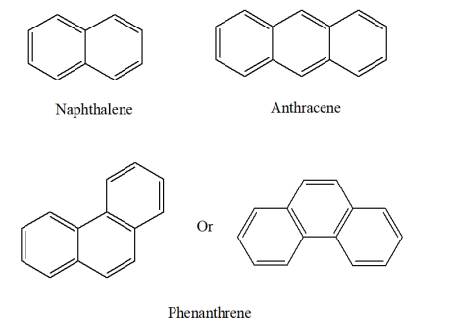
Dr. Debojyoti Tarafdar
Polynuclear Hydrocarbon:
Organic compounds consisting of two or more fused aromatic rings. Two aromatic rings that share a pair of cabon atoms are said to be fused.

Slide 3
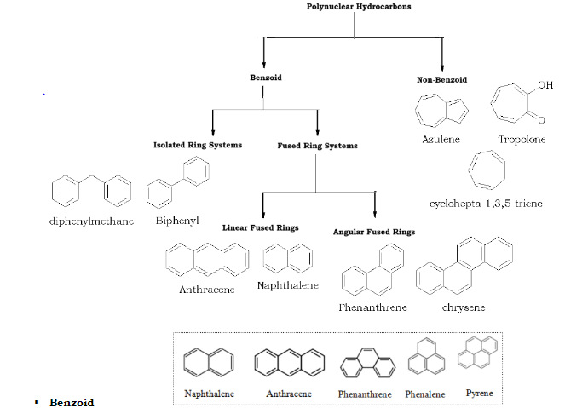
Dr. Debojyoti Tarafdar
Classification:

Slide 4
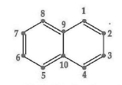
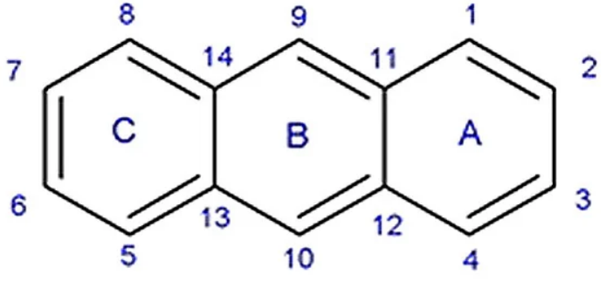
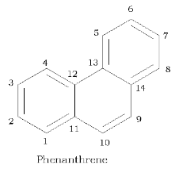
Numbering of C-atoms
Dr. Debojyoti Tarafdar
Napthalene
Anthracene

Slide 5
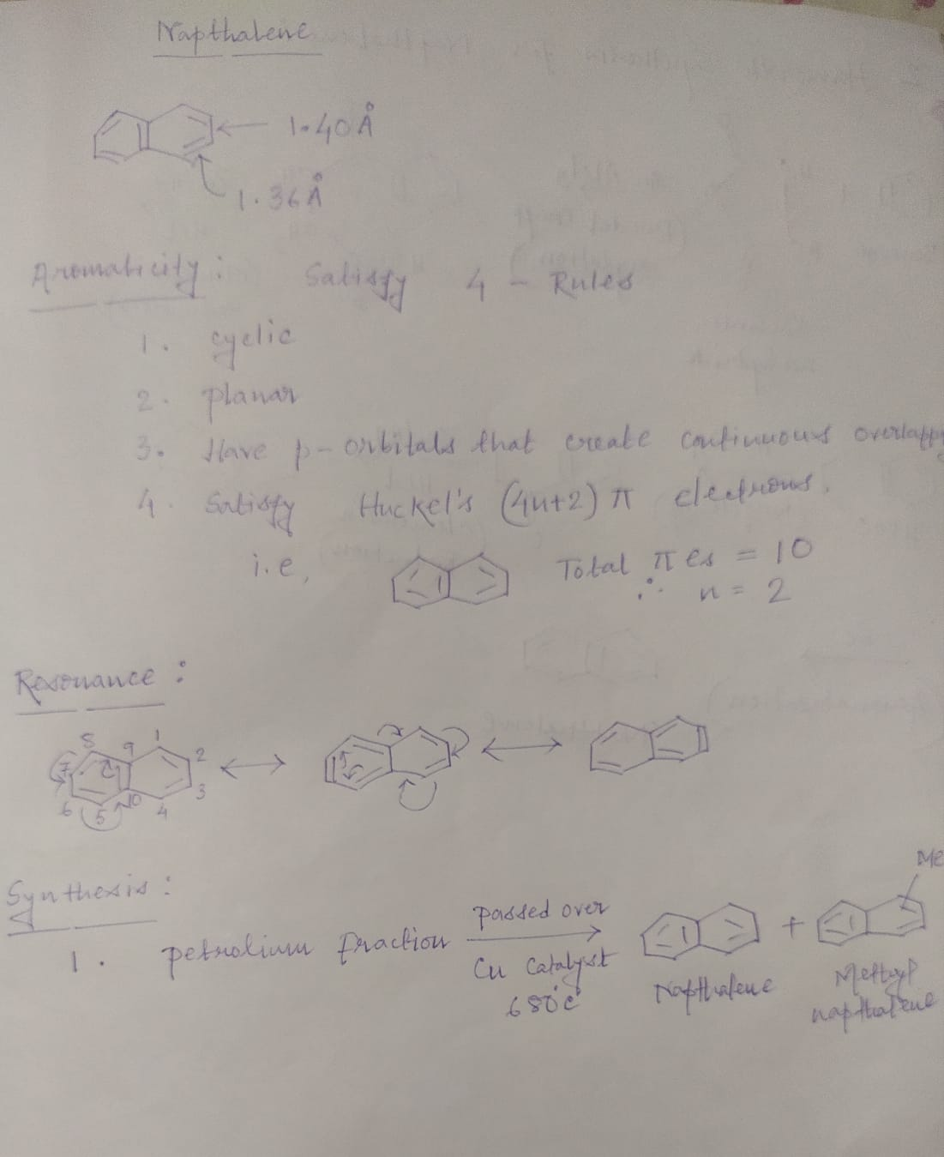
Dr. Debojyoti Tarafdar

Slide 6
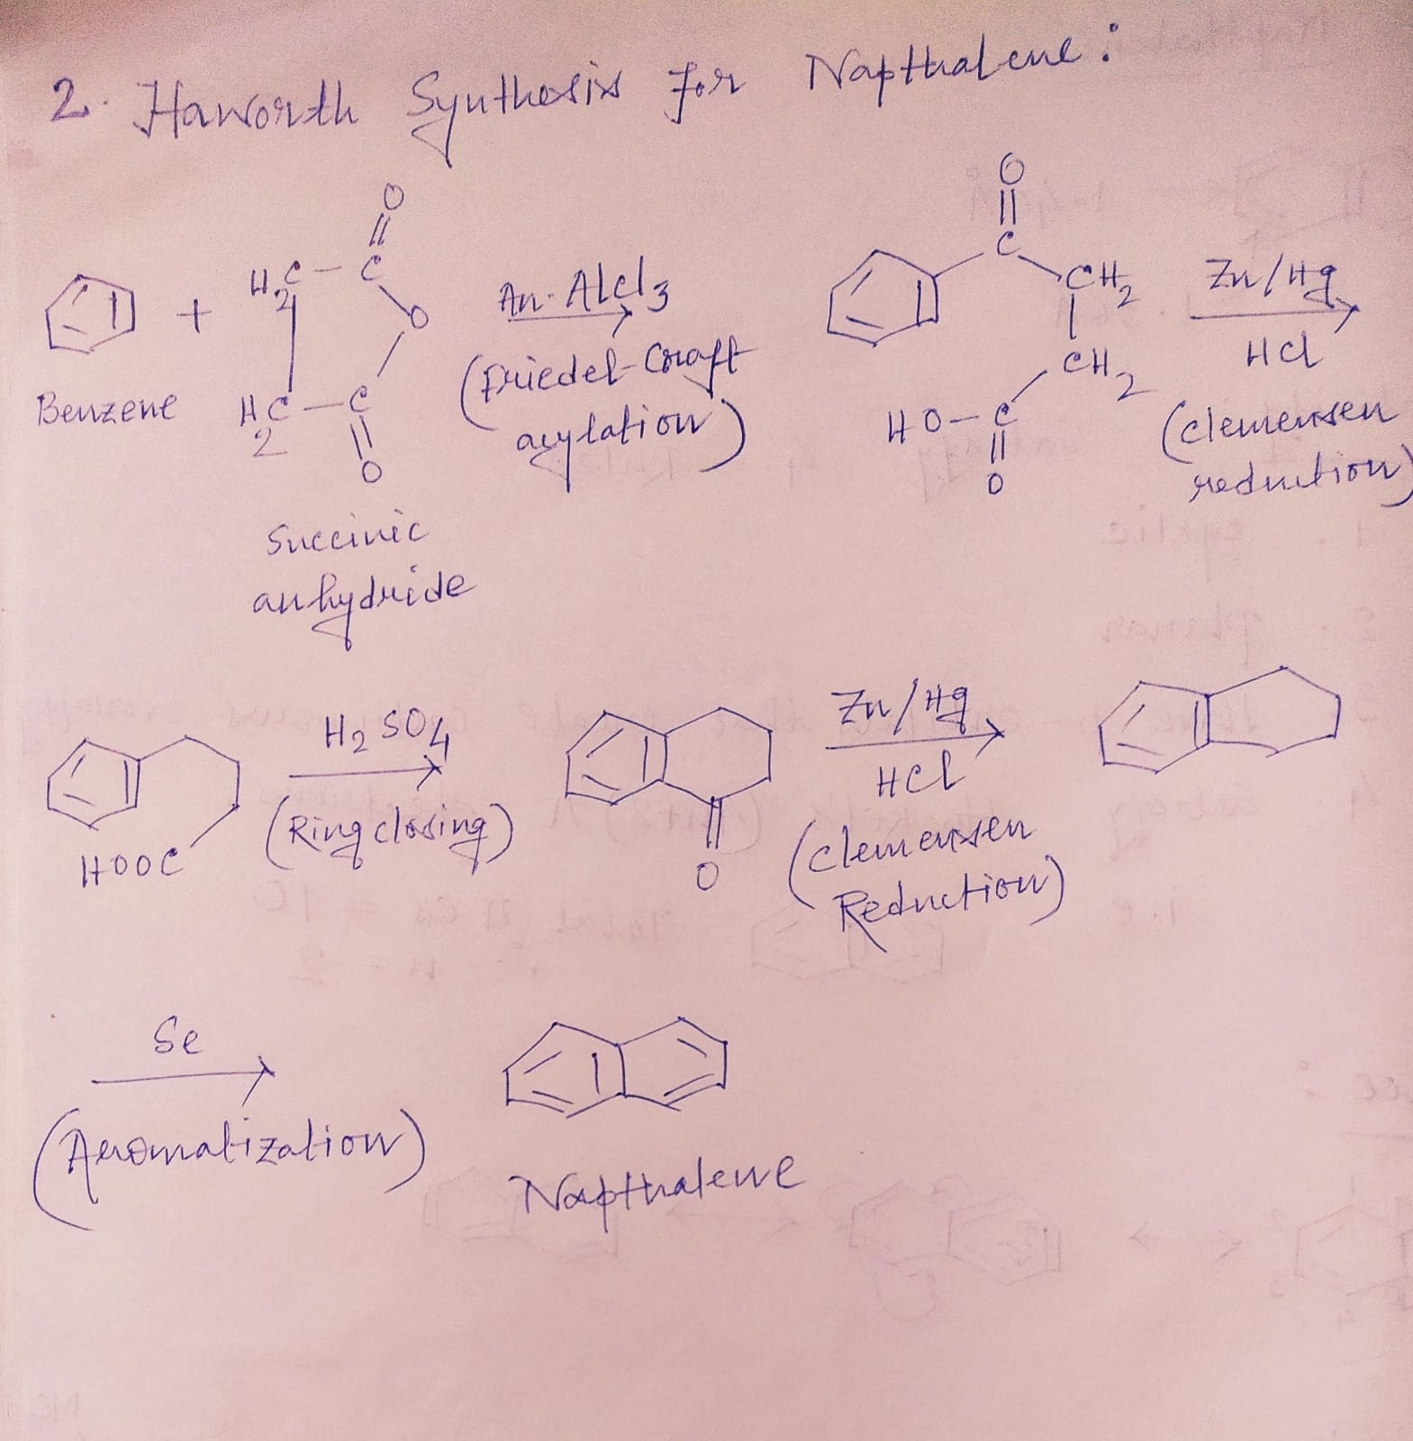
Dr. Debojyoti Tarafdar

Slide 7


