Slide 1
SEMESTER-VI
Organic Chemistry
Paper- CEMMJ 12 (Major)
Topic: Polynuclear Hydrocarbon
Material 2
Lecture- 2
By
Dr. Debojyoti Tarafdar

Slide 2

Dr. Debojyoti Tarafdar
Fries rule and Clar’s rule:
Stability and reactivity of Resonating structure of polycyclic aromatic hydrocarbons (PAHs).
Fries Rule:
Suggests that the resonance structure with the highest number of benzenoid rings (Kekulé rings) is the most stable. Quinonoid structures are less stable, so the formula aims to avoid them.
Example:
For Naphthalene:
Resonating structures:
(i)
(ii)
(iii)
Benzenoid resonating structure
Marked with * :
*
*
*
*
(i)
(ii)
(iii)

Slide 3
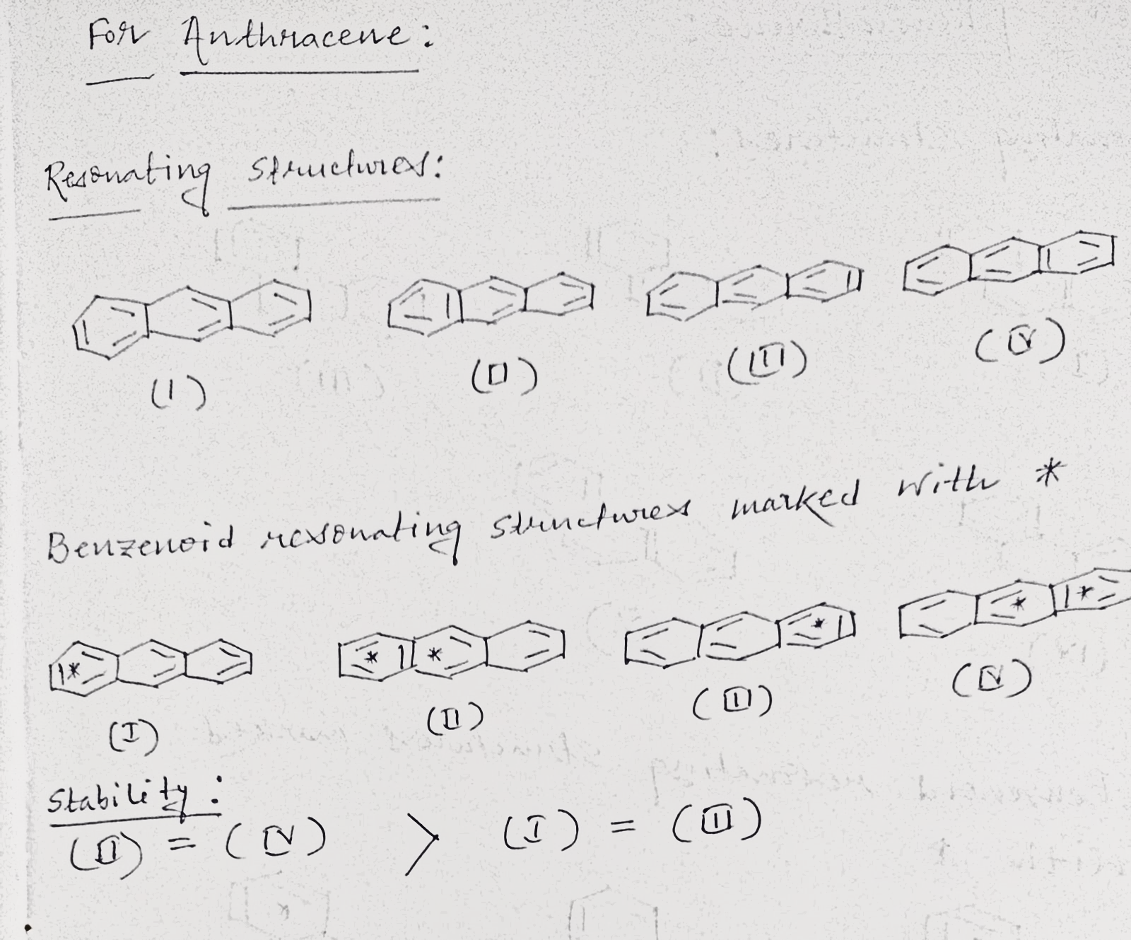
Dr. Debojyoti Tarafdar
Hence, stability:
(ii) > (i) = (iii)
For Anthracene:

Slide 4
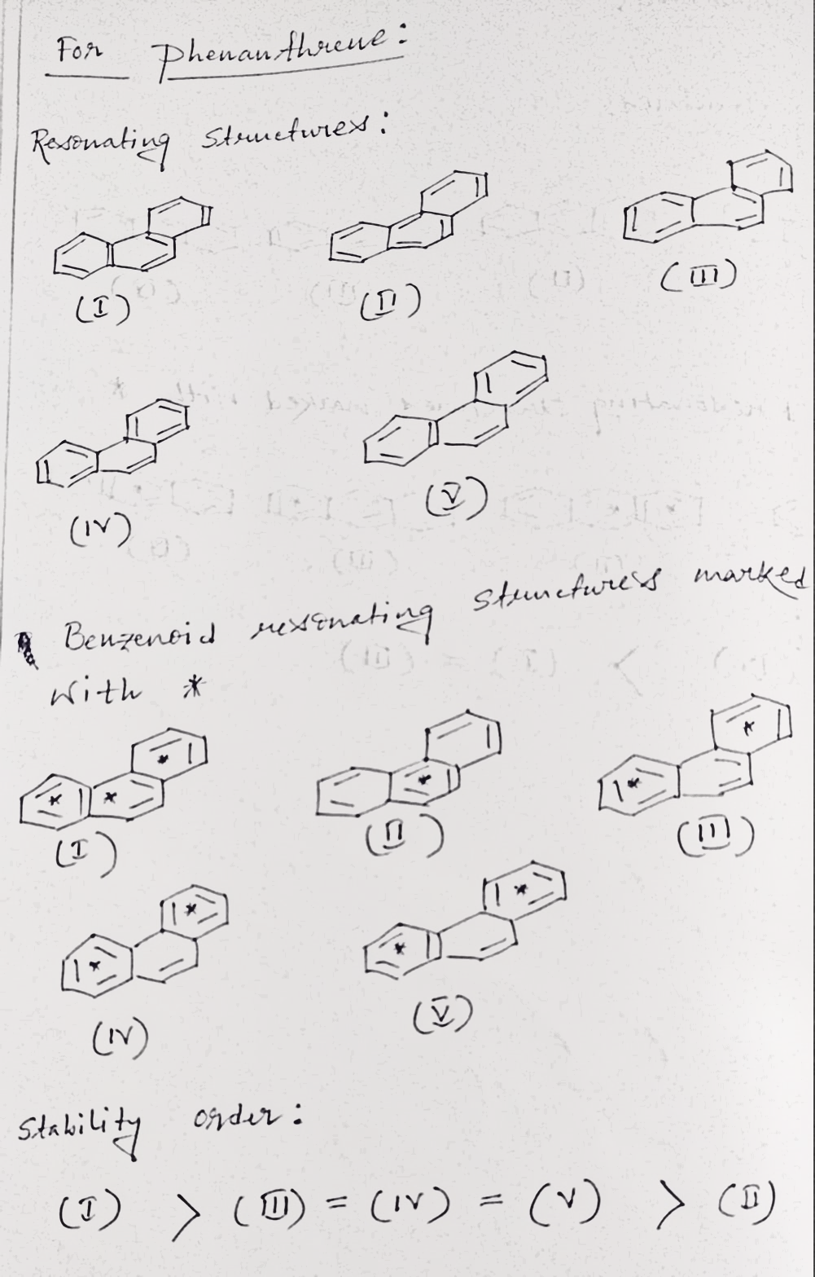
For Phenanthrene:
Dr. Debojyoti Tarafdar

Slide 5


