Slide 1
SEMESTER-VI
Organic Chemistry
Paper- CEMMJ 12 (Major)
Topic: Polynuclear Hydrocarbon
Material 3
Lecture- 3
By
Dr. Debojyoti Tarafdar

Slide 2
Dr. Debojyoti Tarafdar
Fries rule and Clar’s rule:
Stability and reactivity of Resonating structure of polycyclic aromatic hydrocarbons (PAHs).
Clar’s Rule:
The most stable resonance structure of a PAH is the one with the largest number of disjoint aromatic π-sextets (benzene-like rings).
Such a resonance structure is called a Clar structure.
Rule of drawing Clar Structures:
Each vertex belongs to either a double bond or a sextet circle.
Circles (sextets) never join adjacent rings.
Rings with three double bonds are always represented by circles.
An arrow is drawn from circle to adjacent double bonded ring to indicate migrating sextets

Slide 3
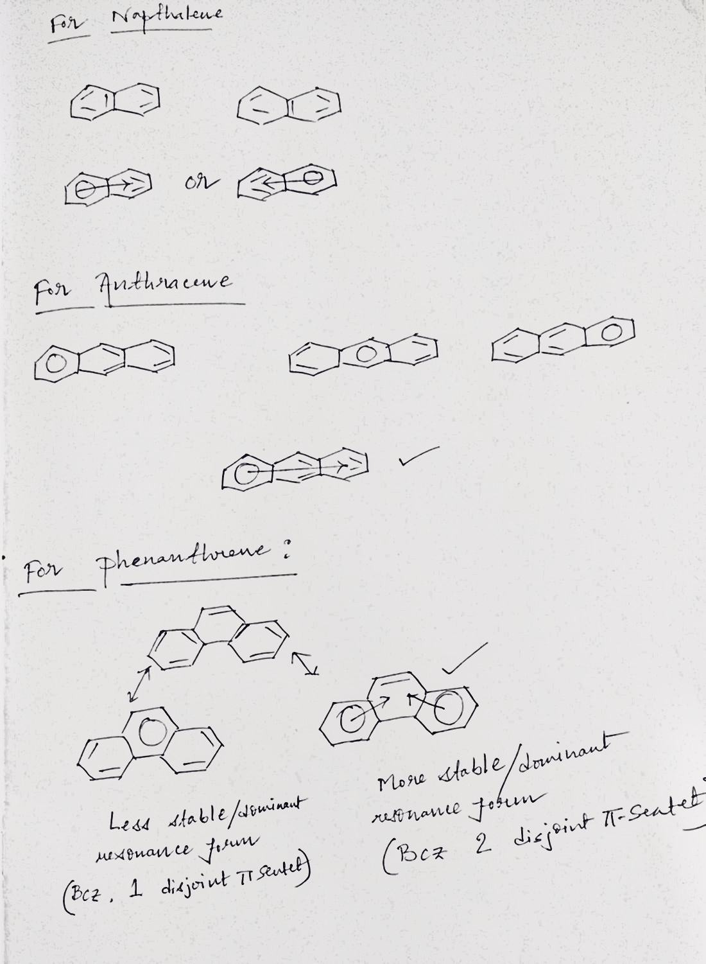
Dr. Debojyoti Tarafdar
Greater number of Disjoint π-Sextet
More dominating / More stable

Slide 4
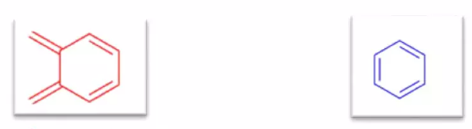
Dr. Debojyoti Tarafdar
Points to be remembered:
Greater number of sextet/benzenoid larger will be stability. Less reactive it would be.
Greater number of quinonoid less will be the stability. High reactive it would be
Greater number of Sextet/Benzenoid
Greater stability
Less reactive
Greater number of Quinonoid
Less stability
Highly reactive
Quinonoid
Benzenoid/Disjoint π-Sextet

Slide 5
Dr. Debojyoti Tarafdar
Stability order:
Benzene > Phenanthrene > Napthalene > Anthracene
Reactivity order:
For addition reaction: Anthracene > Phenanthrene > Napthalene > Benzene
For Electrophilic substitution reaction: Phenanthrene > Anthracene > Napthalene > Benzene

Slide 6
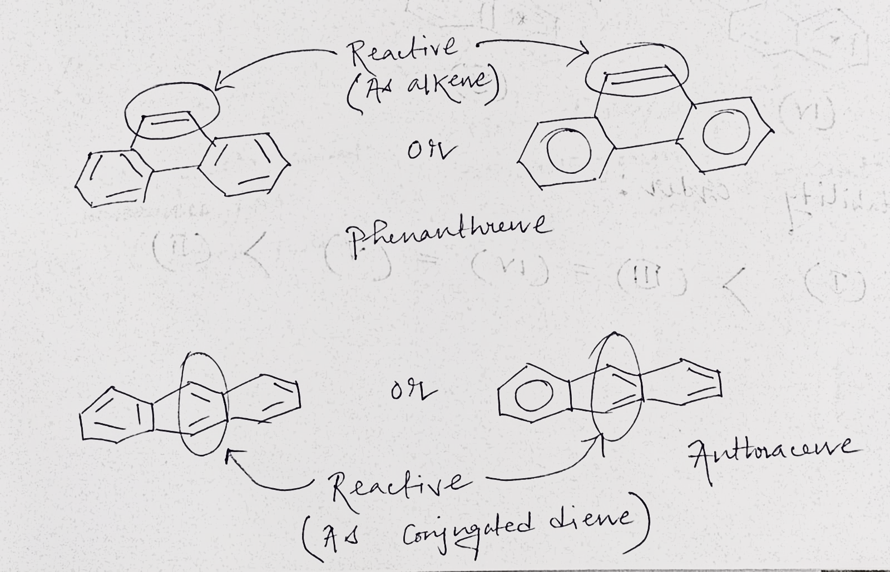
Dr. Debojyoti Tarafdar
Reactive Site:

Slide 7


